Slide 1
8051 Interrupts

Slide 2
Interrupt Fundamentals
During program execution, if peripheral device needs service from microcontroller device will generate interrupt and then gets the service from microcontroller.
When peripheral device activate the interrupt signal, the processor branches to a program called interrupt service routine.
After executing the interrupt service routine the processor returns to the main program.

Slide 3
Steps taken by processor while processing an interrupt:
It completes the execution of current instruction.
PSW is pushed to stack.
PC content is pushed to stack.
Interrupt flag is reset.
PC is loaded with ISR address.
ISR will always ends with RET instruction. The execution of RET instruction results in –
POP the current stack top to PC.
POP the current stack top to PSW.

Slide 4
Interrupt Fundamentals
Whenever any peripheral device needs microcontroller’s service, the device notifies the microcontroller by sending it an interrupt signal.
An interrupt is an external or internal event that interrupts the microcontroller to inform it that a device needs it service.
Interrupt can be a hardware or a software interrupt.
Interrupts can be disabled or enabled.

Slide 5
Interrupt Fundamentals
Upon receiving an interrupt signal, microcontroller finishes the instruction execution and serves the device.
The program which is associated with the interrupt is called the interrupt service routine.
For every interrupt, there is a fixed location in memory for ISR.
The group of memory locations set aside to hold the addresses of ISRs is called interrupt vector table.

Slide 6
Attending Interrupts
The microcontroller finishes the instruction it is executing and saves the address of the next instruction (PC) on the stack.
It also saves the current status of all the interrupts internally.
It gets the address of the ISR from the interrupt vector table and jumps to it.
It starts to execute the interrupt service subroutine until it reaches the last instruction of the subroutine which is RETI (return from interrupt).
Upon executing the RETI instruction, the microcontroller returns to the place where it was interrupted.

Slide 7
8051 Interrupts
There are six interrupts in 8051.
Power on reset
Two external interrupts (INT0’ and INT1’): P3.2 and P3.3
Two timer interrupt (for Timer0 and Timer1)
Serial port interrupt (for both transmit and receive)

Slide 8
Classification of interrupts:
External and Internal interrupts: External interrupts are those initiated by peripheral devices through the external pins of microcontroller. Internal interrupts are activated by internal peripherals of microcontrollers.
Maskable and Non-maskable interrupts: Maskable interrupts can be disabled by the processor using program. Programmer cannot disable non-maskable interrupts by program.
Vectored and Non-vectored interrupts: In vectored interrupts, the starting address (vector address) is predefined. In non-vectored interrupts the starting address is provided by the peripherals.

Slide 9
Peripheral Device Microcontroller
request
INTA
acknowledgement signal
send the interrupt vector address

Slide 10
8051 Interrupt Structure:
There are five interrupts. Two external interrupts and three internal interrupts. All these interrupts are maskable and vectored interrupts.
External interrupt 0 (0003 H) – Highest Priority
Timer 0 interrupt (000B H)
External interrupt 1 (0013 H)
Timer 1 interrupt (001B H)
Serial interrupt (0023 H) – Lowest Priority

Slide 11
8051 makes use of two registers to deal with interrupts:
IE – Interrupt Enable
IP – Interrupt Priority
Both are 8-bit registers.

Slide 12
Interrupt Table
Interrupt | Type of Interrupt | Pin/SFR bit | ROM Location
Reset | Hardware | 9 | 0000 H
INT0 | Hardware | P3.2 (12) | 0003 H
Timer0 (TF0) | Software | TCON.5 | 000B H
INT1 | Hardware | P3.3 (13) | 0013 H
Timer1 (TF1) | Software | TCON.7 | 001B H
Serial Com (RI and TI) | Software | SCON.0 and SCON.1 | 0023 H

Slide 13
Enable/Disable Interrupt
Upon reset, all interrupts are disabled (masked)
The interrupts must be enabled by software in order for the microcontroller to respond to them
IE (Interrupt Enable) register is responsible for enabling (unmasking) and disabling (masking) the interrupts

Slide 14
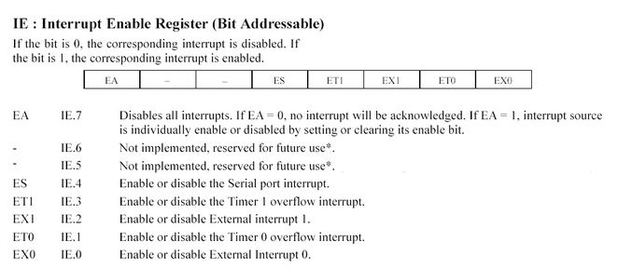

Slide 15
Hardware Interrupts: INT0’ and INT1’
Four bits (lower nibble) of TCON register are used for external interrupts INT0’ and INT1’.
IT1/IT0: Level/Edge triggering of external interrupt.
0 – Low logic level triggered;
1 – Falling edge triggered;
IE1/IE0: Set when INT1/INT0 is detected.
Bit | D7 | D6 | D5 | D4 | D3 | D2 | D1 | D0
TCON | TF1 | TR1 | TF0 | TR0 | IE1 | IT1 | IE0 | IT0

Slide 16
Timer Interrupts:
First four bits (higher nibble) of TCON register are used for timer interrupts.
TR1/TR0: Turning on/off Timer 1/0.
TF1/TF0: Overflow of Timer 1/0.
If the timer interrupt in the IE register is enabled, whenever TF is raised, the microcontroller jumps to the interrupt vector table to service the ISR.
Bit | D7 | D6 | D5 | D4 | D3 | D2 | D1 | D0
TCON | TF1 | TR1 | TF0 | TR0 | IE1 | IT1 | IE0 | IT0

Slide 17
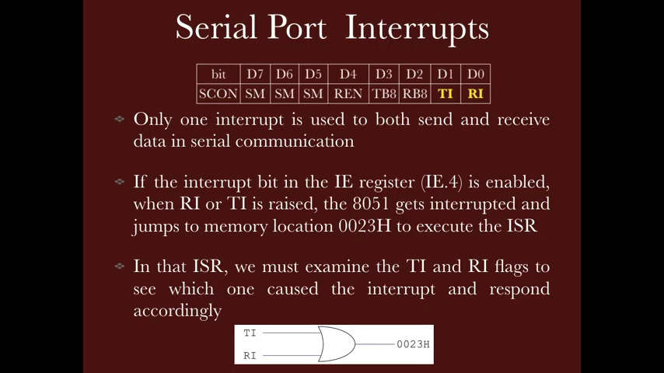

Slide 18
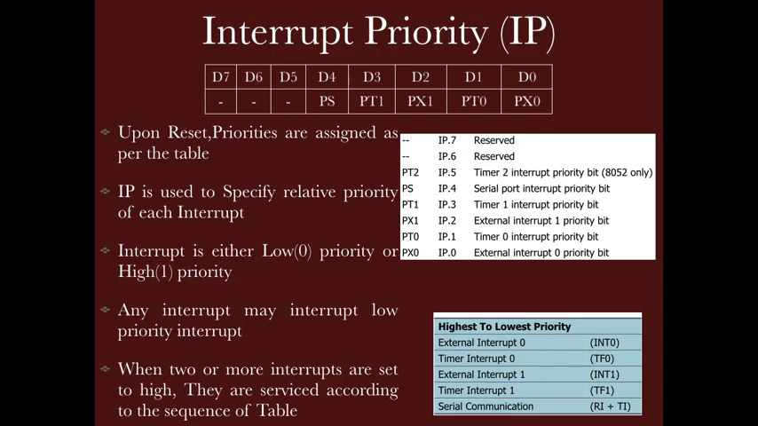

Slide 19
